Slide 1
Report on Crop Production Analysis in India
Reported By
K. Dhivya

Slide 2
Introduction:
India is the second largest producer of wheat and rice, the world's major food staples.
India is currently the world's second largest producer of several dry fruits, agriculture-based textile raw materials, roots and tuber crops, pulses, farmed fish, eggs, coconut, sugarcane and numerous vegetables.
Lets see some of the crop production analysis between the year 1996 and 2015.

Slide 3
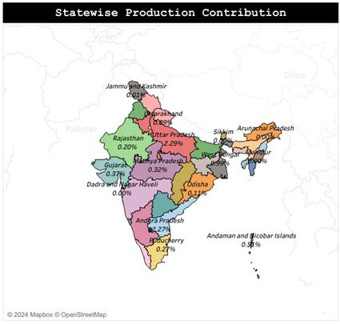

Slide 4
The contribution of states in Crop Production:
The different states produces different crops and in different quantity.
The highest contribution is from Kerala(69.33%) and the lowest from the Chandigarh(0.01%)
The major contribution is shared by Kerala, Andra Pradesh, Tamil Nadu and Uttar Pradesh.

Slide 5
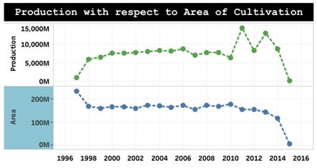
Production Vs Area of Cultivation:
The Production seems to increase steadily even the average area of cultivation decreased over the years.
Production drop is seen in the upcoming years of 2012 and 2014 excluding 2015, since it has very less data in comparison.

Slide 6
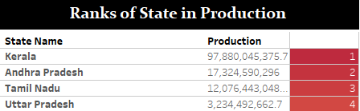

Ranking of states in Crop production:
As we could see the rank table, Kerala(1) is the highest in production followed by Andra Pradesh(2), Tamil Nadu(3), Uttar Pradesh(4), Assam(5), etc.

Slide 7
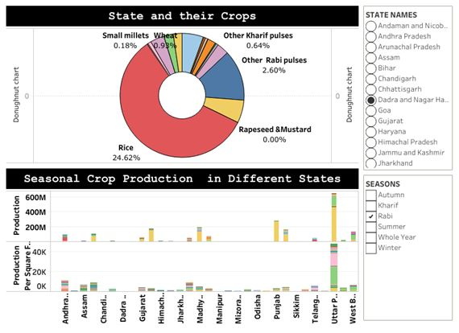
State and their crops:

Slide 8
The different states produces different crops based on their soil type and also with respect to the seasons.
There are different type of seasons as different categories in the dataset as follows:
Autumn
Kharif
Rabi
Summer
Whole year
Winter
The whole year category has the maximum number of crops in production.

Slide 9
Excluding the ‘Whole year’ seasonal category, the Kharif season produces 59.69% of the total seasonal category of production ,the Rabi season produces 30.39% of production, the winter season produces 6.44% of production, the summer season produces 2.53% of production and the autumn season produces 0.95% of production.

Slide 10
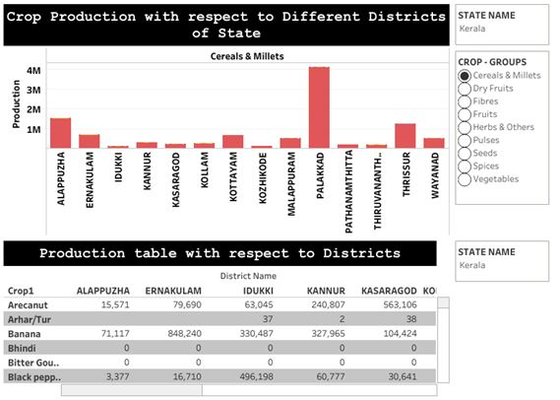
Districts Vs Crop Production:

Slide 11
The production of individual district respective of their states are shown in the previous slide.
The crops are grouped into different categories as Cereals & Millets, Dry fruits, Fibres, Fruits, Herbs & Others, Pulses, Seeds, Spices and Vegetables.
Fruits top in the production among those crop group and the spices are least in production among these.

Slide 12
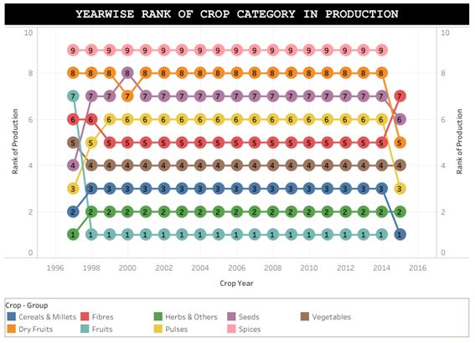
Rank of Crop Category in Production:

Slide 13
The ranks of each grouped crop category with respective of each year is depicted in the image of previous slide.
The fruits category in which the coconut is highest in production and ranks top in production from 1998 to 2014.
Most of the crop category are constant in their rank throughout the years irrespective of drops in particular year.

Slide 14
Conclusion:
The above analysis concludes that seasons contribute the most to the relative production. Apart from ‘the whole year’, ‘Kharif’ season contributes more in production.
Inspite of the decreased area of production in several areas, the production increases due to certain other factors, may be due to good rainfall, healthy soil, etc.
Other than coconut, Sugarcane, Rice, Wheat, Potato are highest in overall production.
Since Kerala is top in the production of coconut with a high percentage than any other crops, we could say that South India makes the highest in production within our country.

